Slide 1
Collection Framework Retrieving Elements from Collections
Enumeration interface Iterator interface ListIterator interface for-each loop
momedaram

Slide 2
Enumeration Interface
We can use Enumeration to get objects one by one from the legacy collection objects.
Vector, HashTable and Stack
We can create Enumeration object by using elements() method.
Vector v = new Vector(); Enumeration e = v.elements();
Stack s = new Stack(); Enumeration e2 = s.elements();
Hashtable h = new Hashtable(); Enumeration e1 = h.elements();

Slide 3
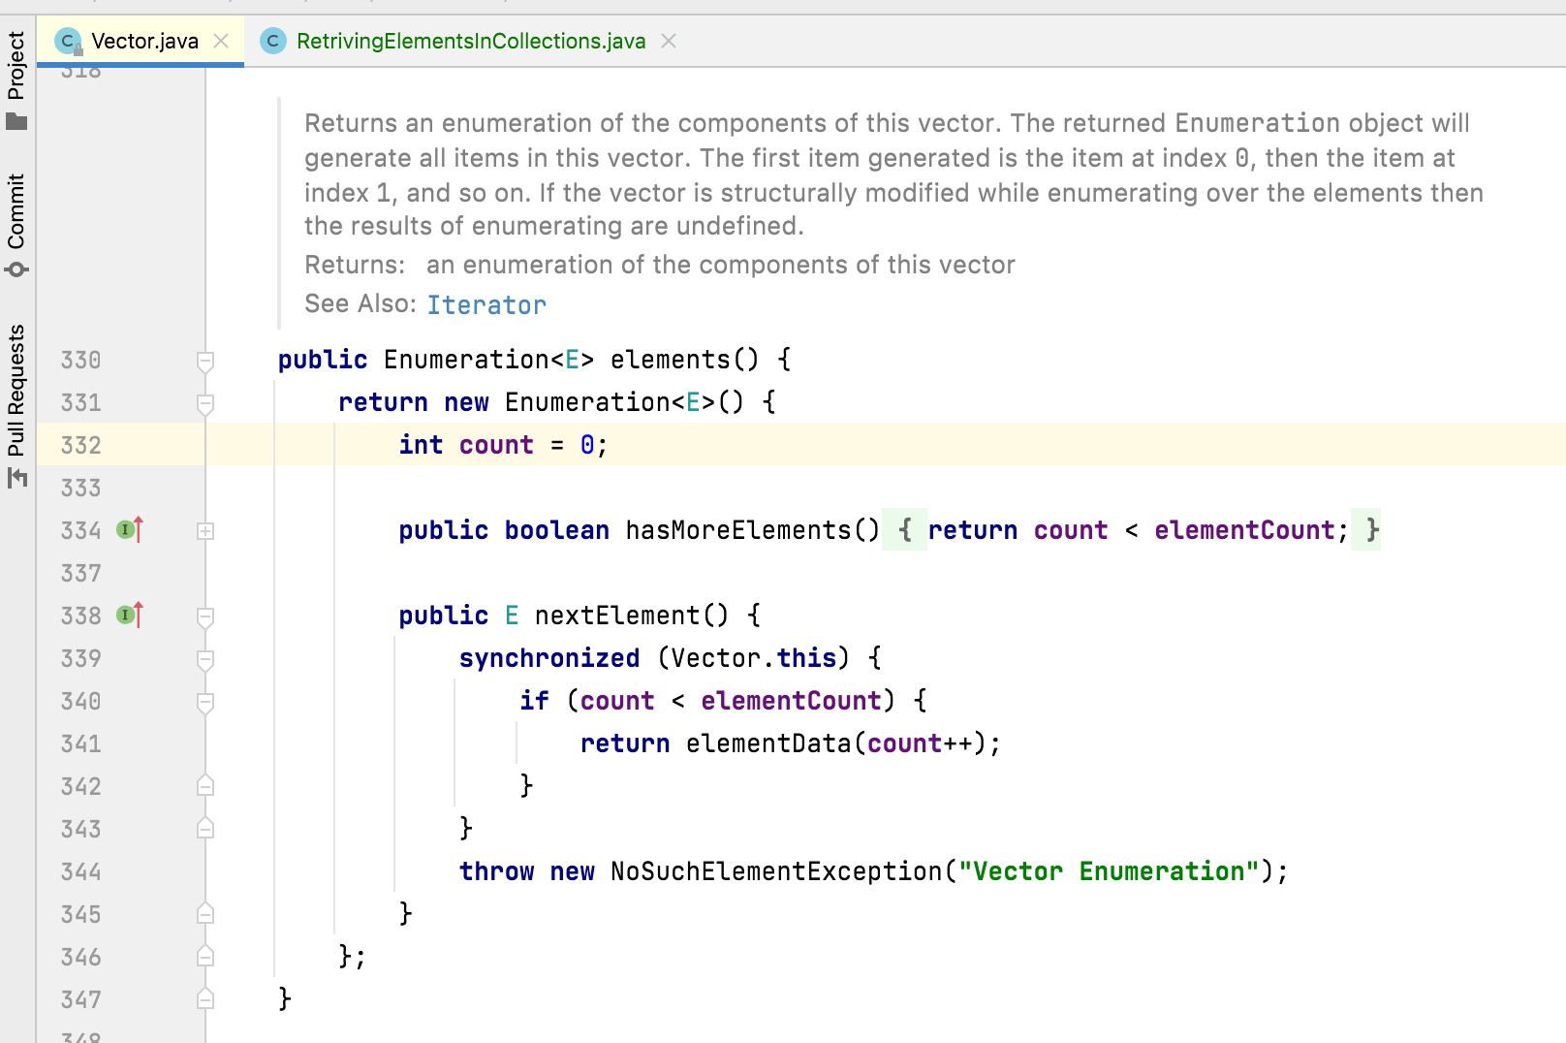

Slide 4
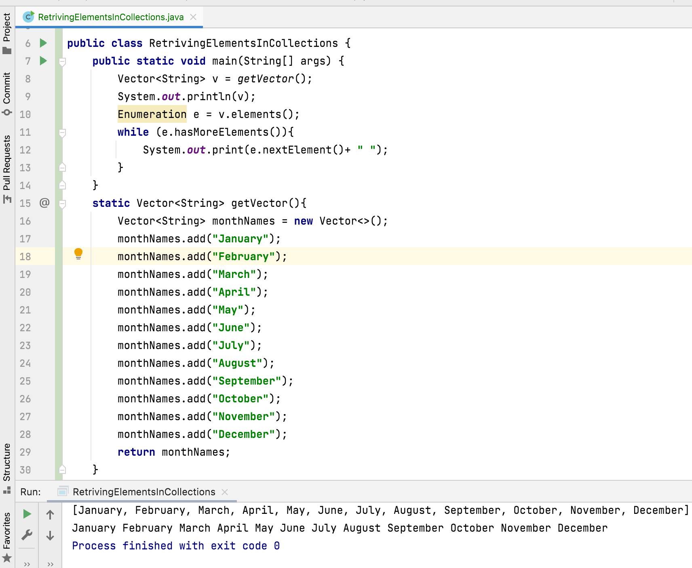
boolean hasMoreElements() – This method tests if the enumeration has any more elements or not.
E nextElement() – This returns next element that is available in the enumeration.

Slide 5
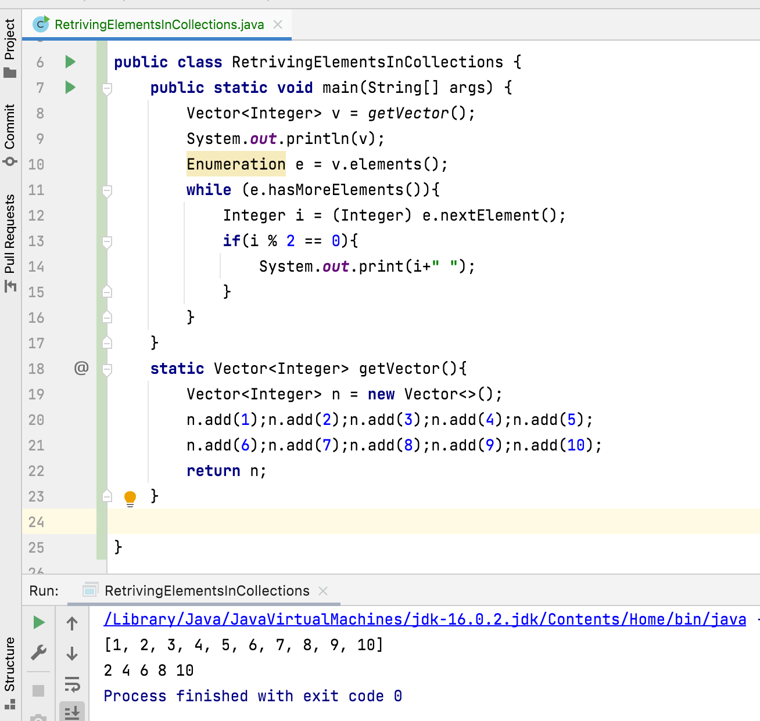

Slide 6
Iterator interface
We can use Iterator to get objects one by one from any collection object.
We can apply Iterator concept for any collection object and it is a universal cursor.
We can create Iterator object by using iterator() method.
ArrayList<Integer> al = new ArrayList<>(); Iterator iterator = al.iterator();
LinkedList<Integer> ll = new LinkedList<>(); Iterator iterator1= ll.iterator();
Vector<Integer> v = new Vector<>(); Iterator iterator2 = v.iterator();

Slide 7
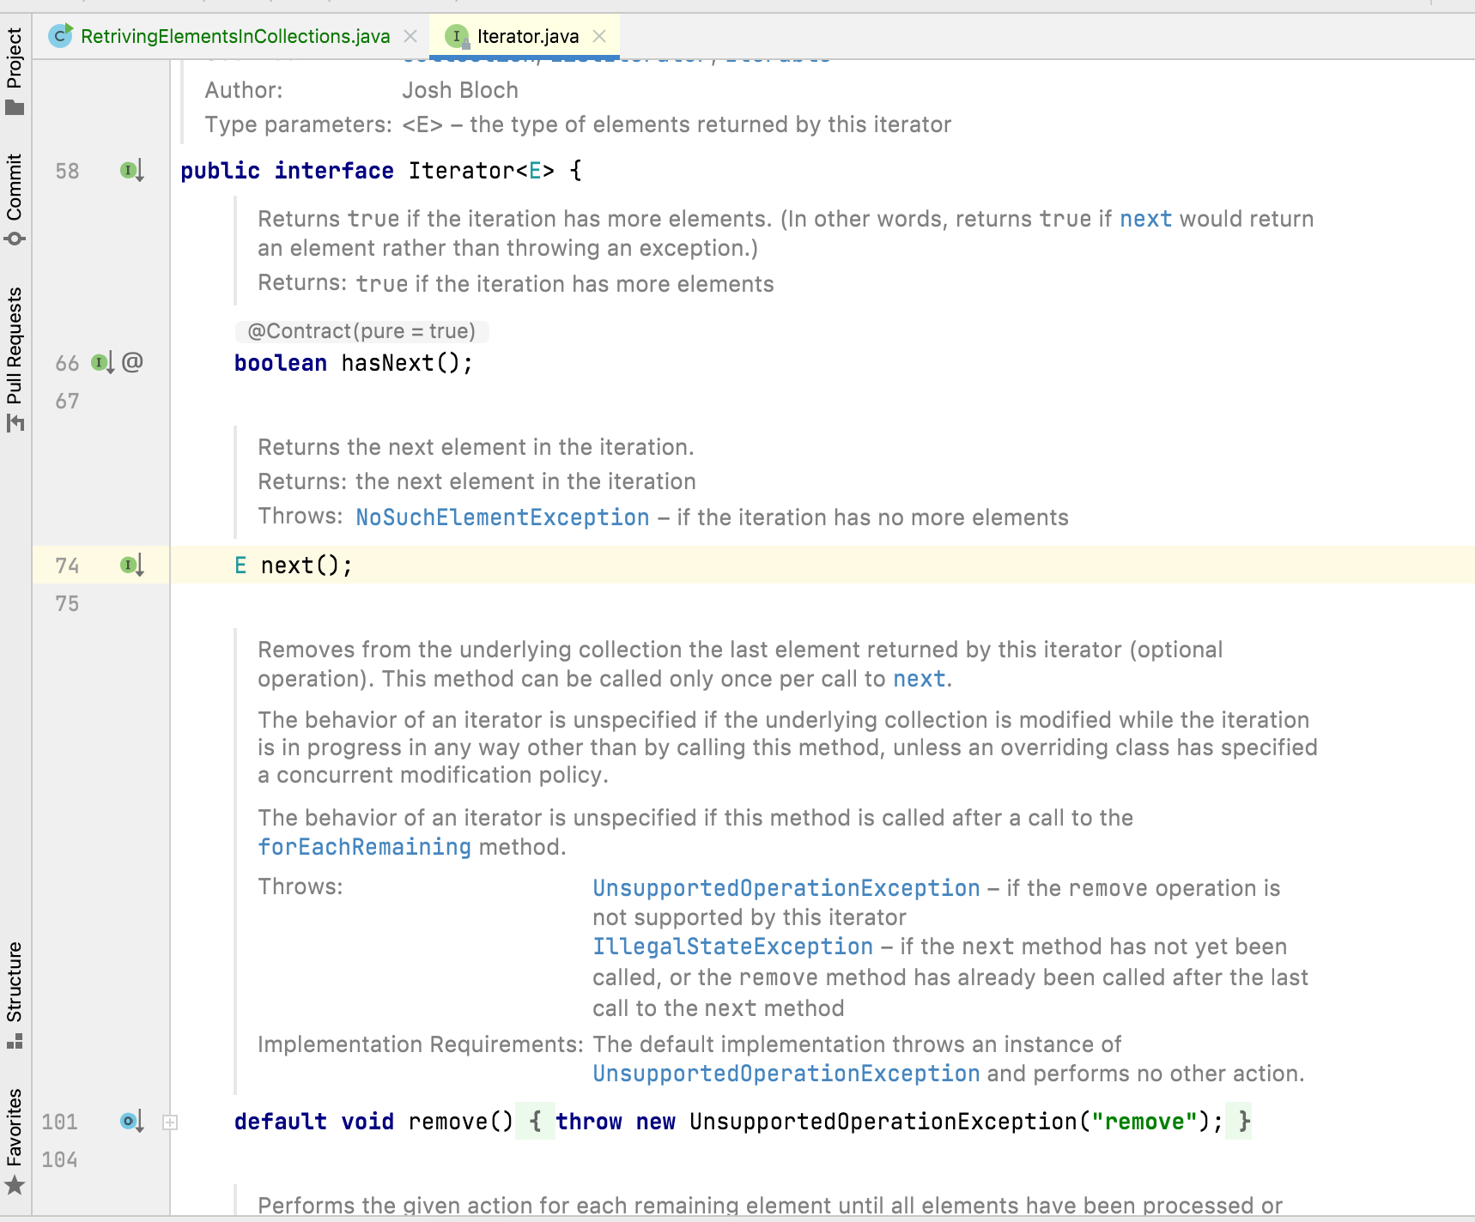

Slide 8
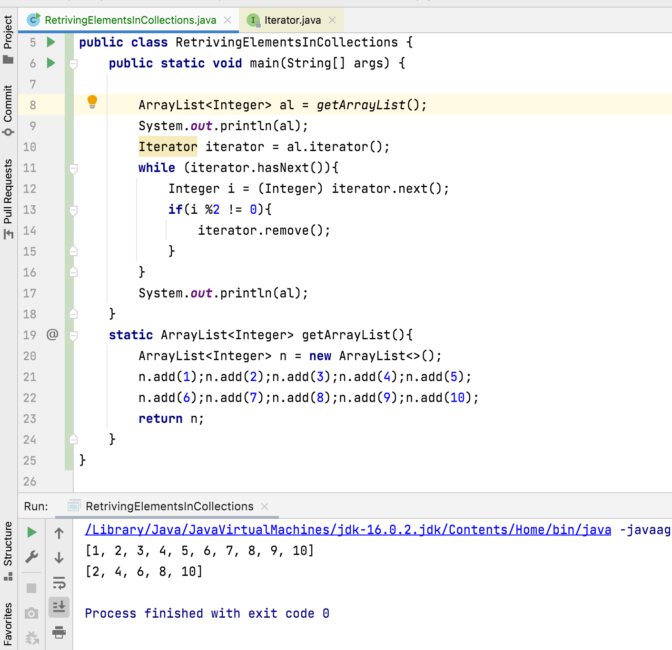

Slide 9
ListIterator Interface
ListIterator is the child interface of Iterator.
By using listIterator we can iterate either to the forward direction (or) to the backward direction, it is a bi-directional cursor.
While iterating using listIterator we can perform replacement and addition of new objects in addition to read and remove operations
We can create ListIterator object by using listIterator() method.
ArrayList<Integer> al = new ArrayList<>(); ListIterator l = al.listIterator();
LinkedList<Integer> ll = new LinkedList<>(); ListIterator l1 = ll.listIterator();
Vector<Integer> v = new Vector<>(); ListIterator l2 = v.listIterator();

Slide 10
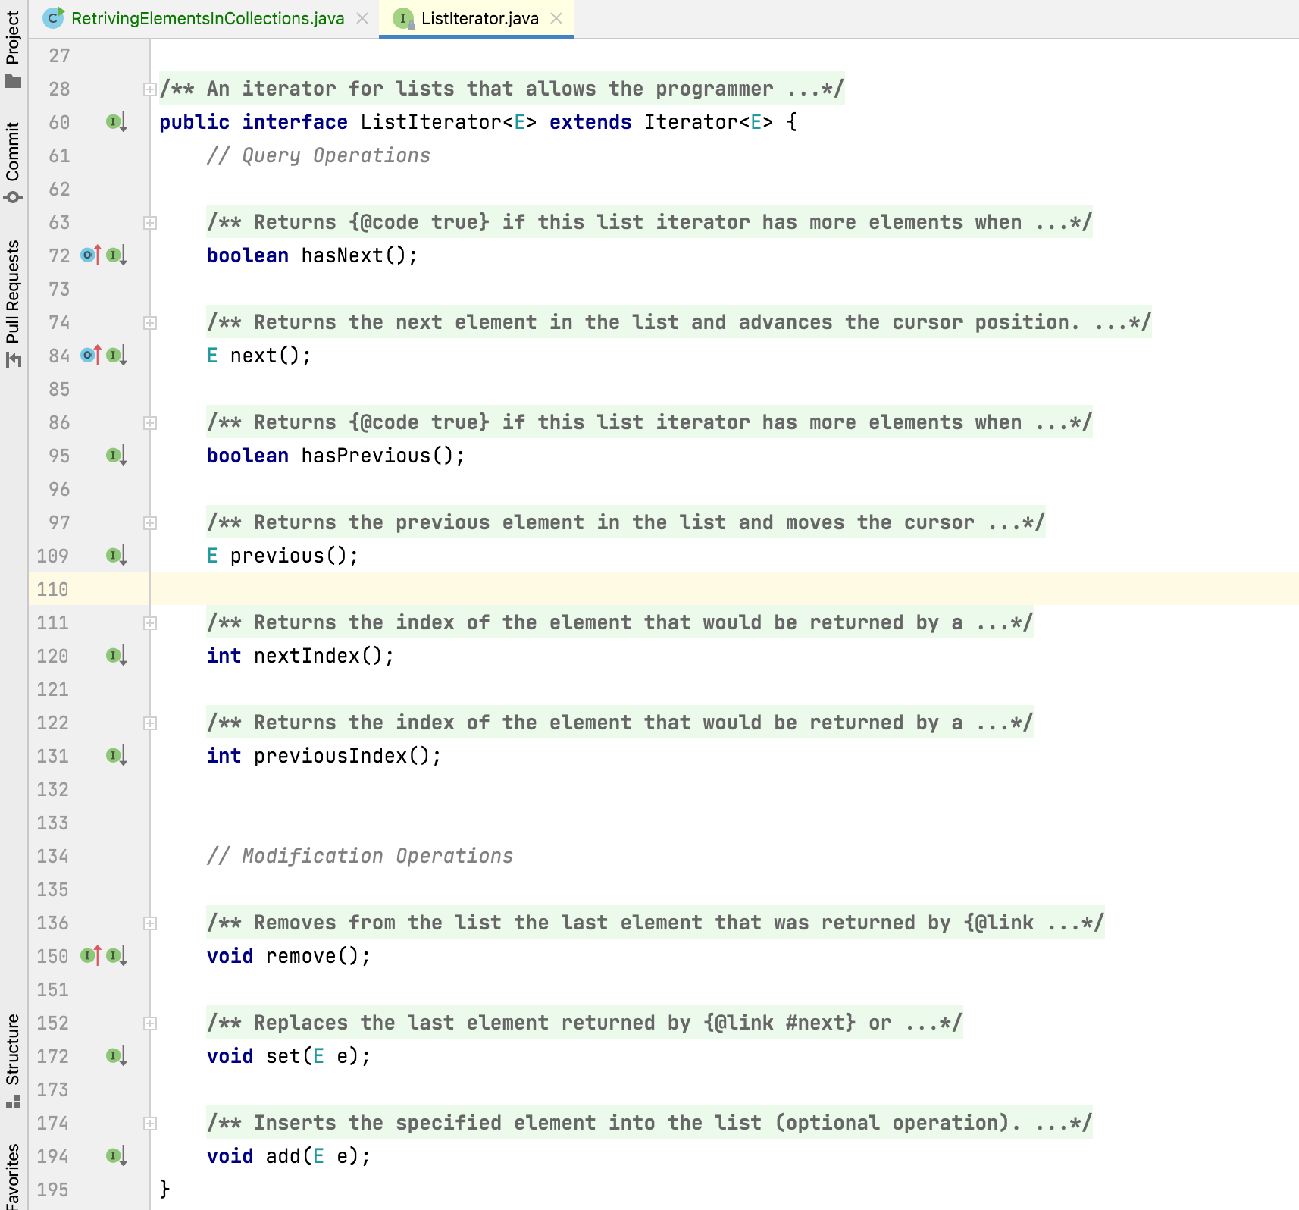

Slide 11
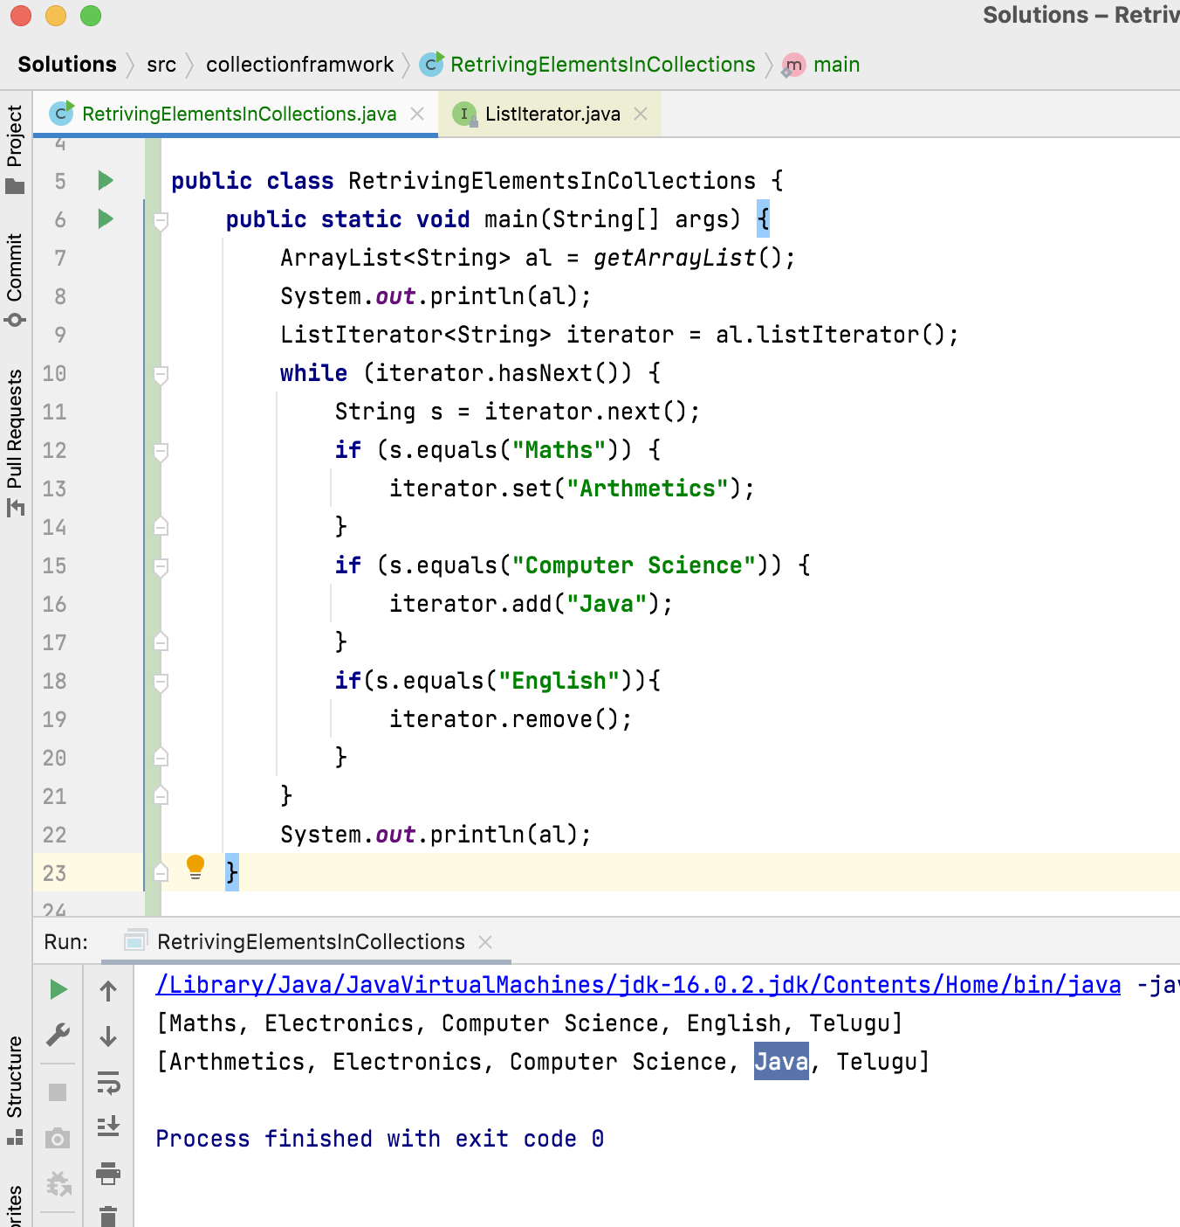



Slide 12
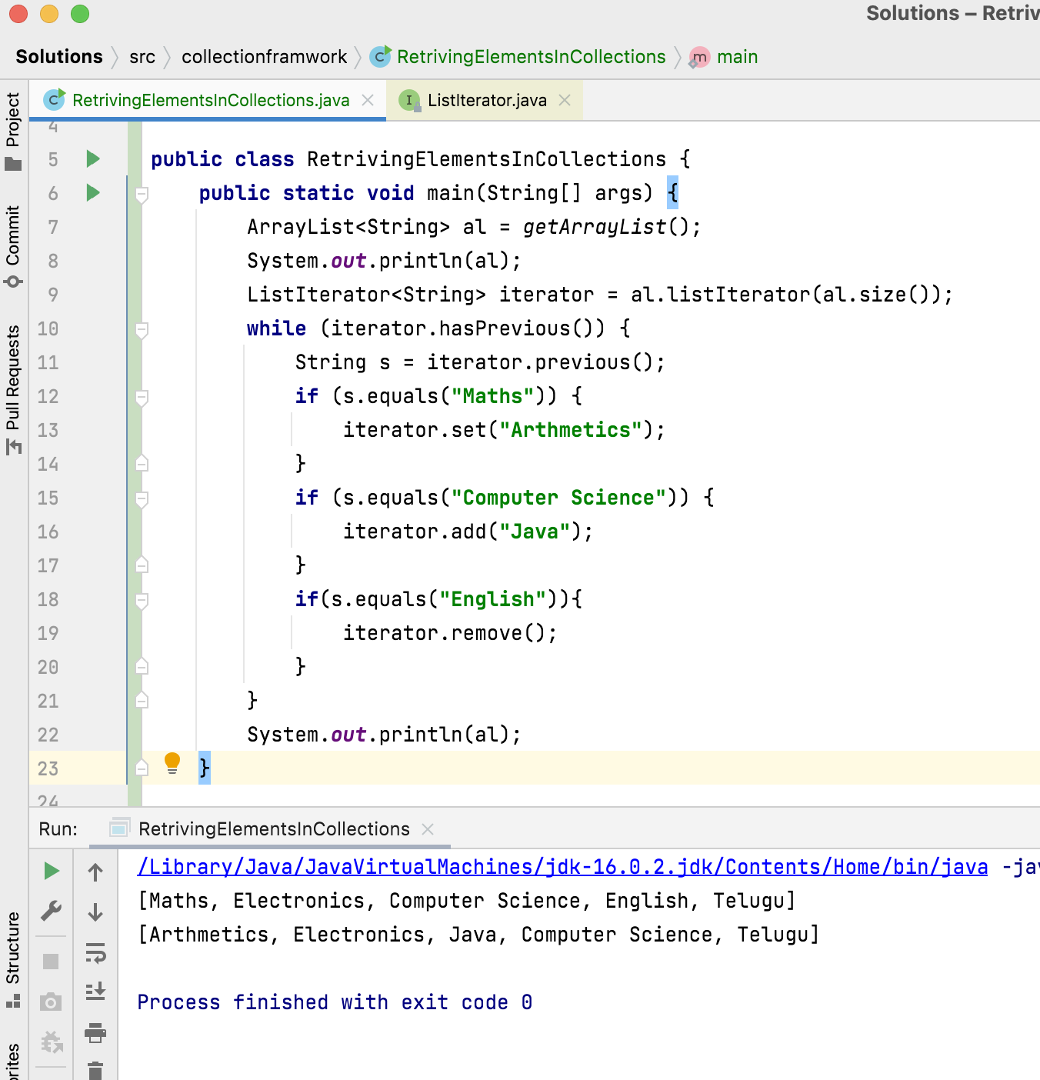



Slide 13
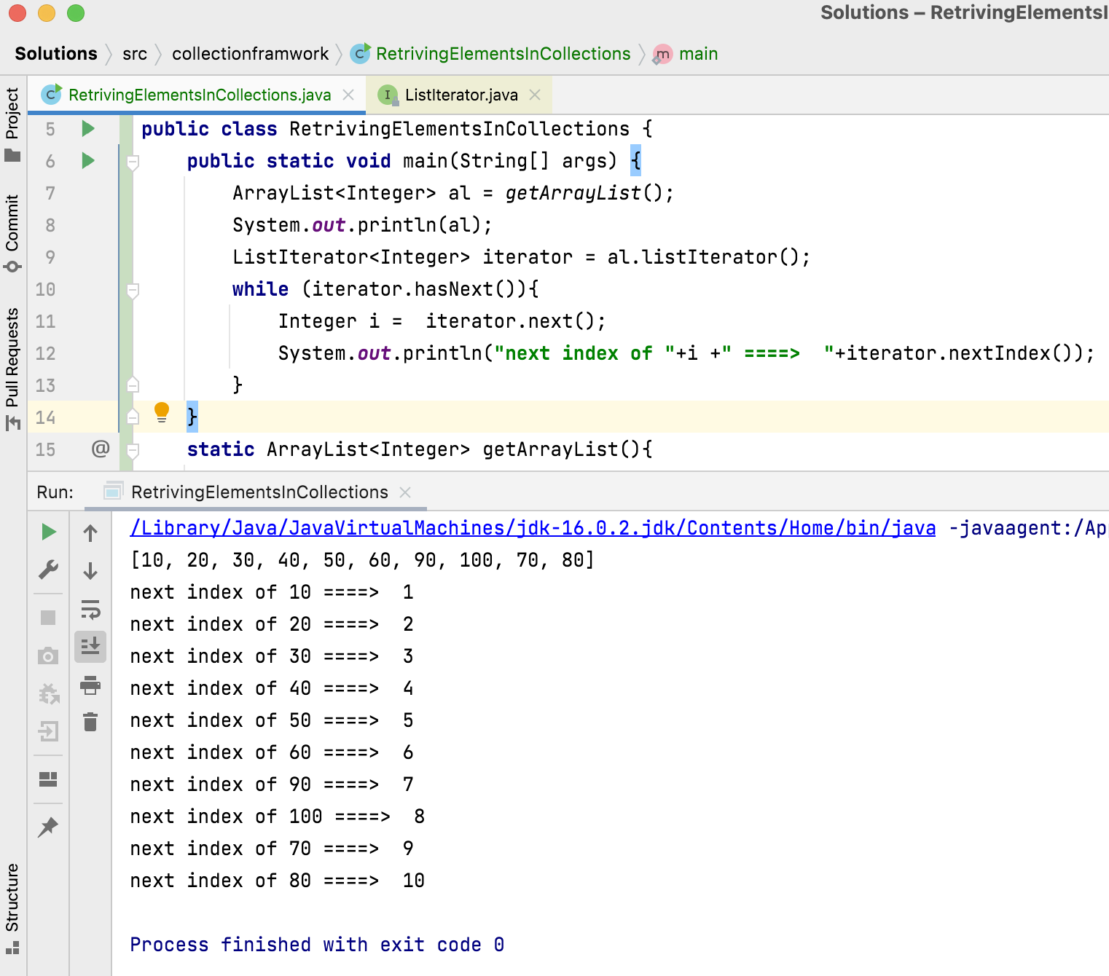
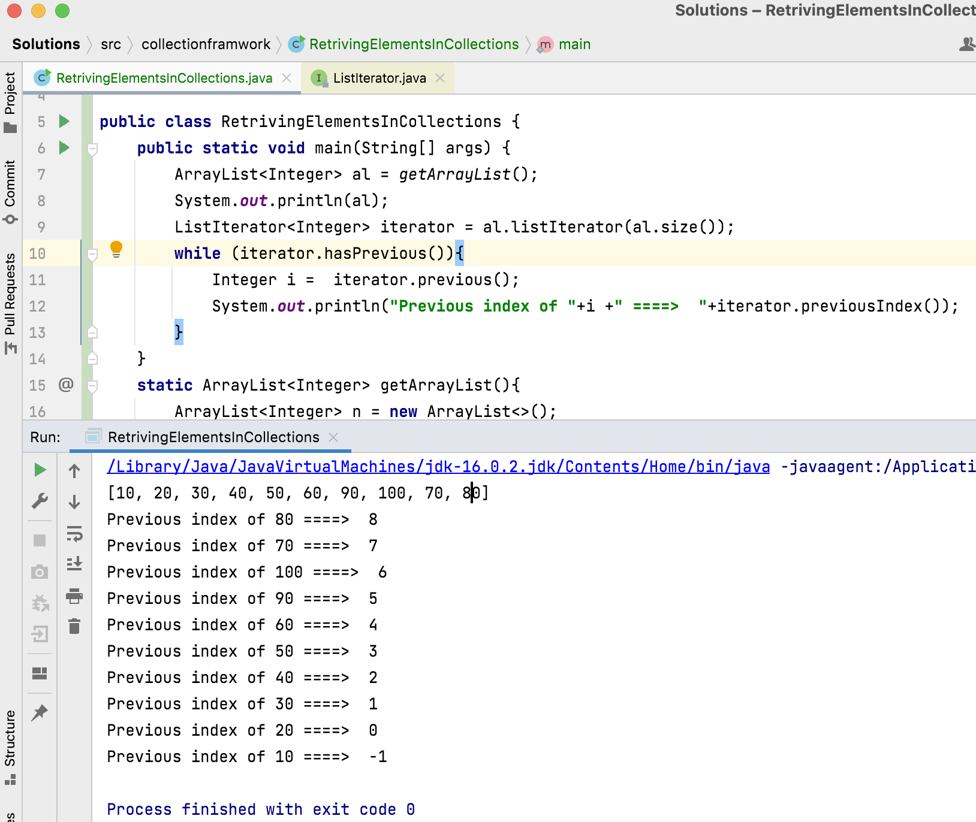

Slide 14
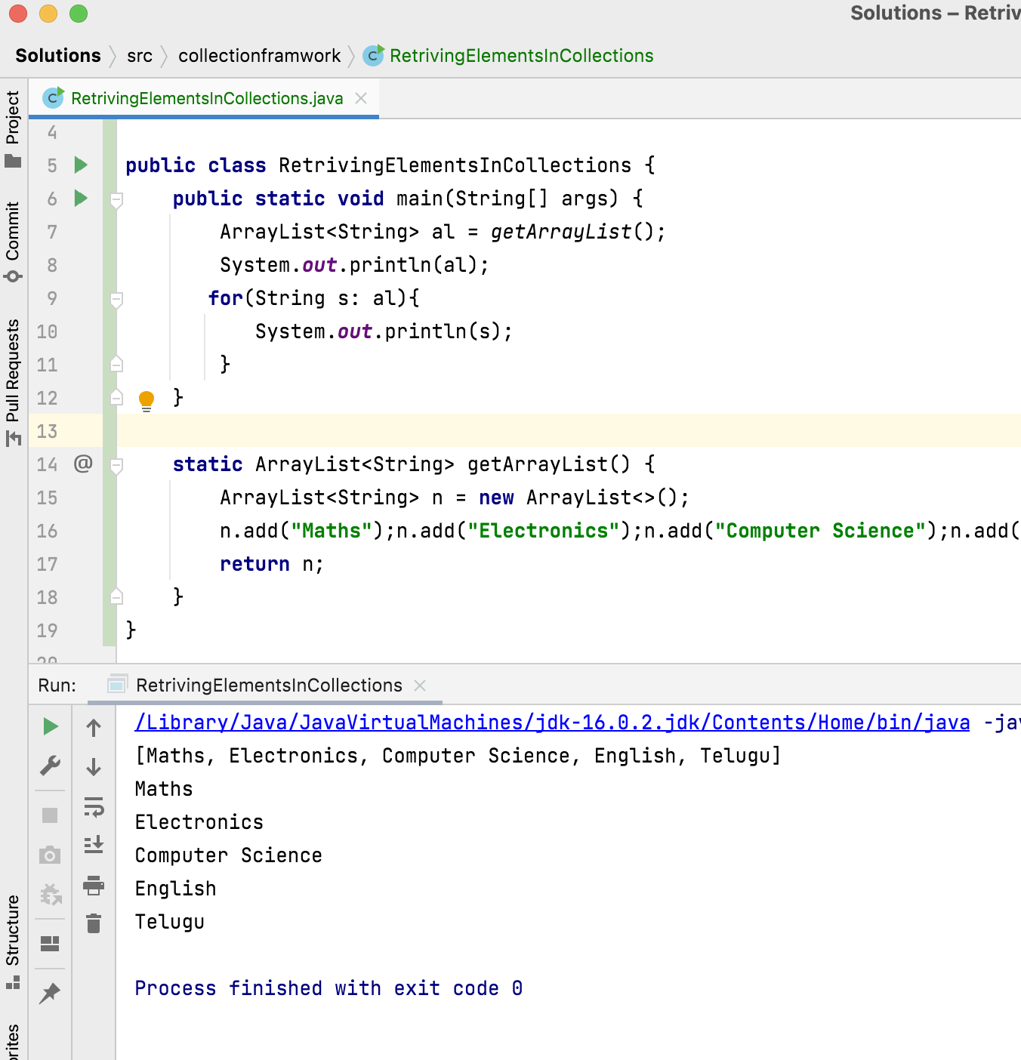
for-each loop

Slide 15
Thank You !
momedaram

